Slide 1
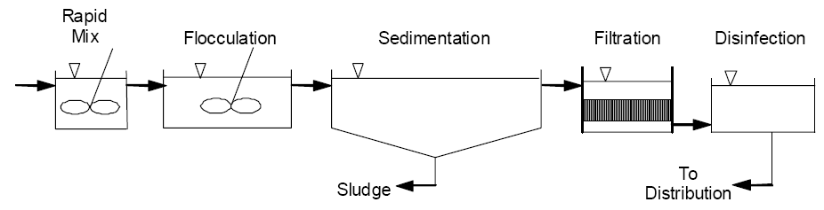
Conventional Surface Water Treatment for Drinking Water

Slide 2
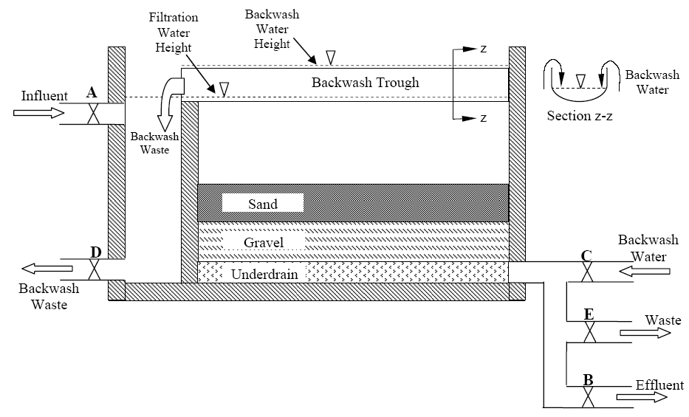

Slide 3
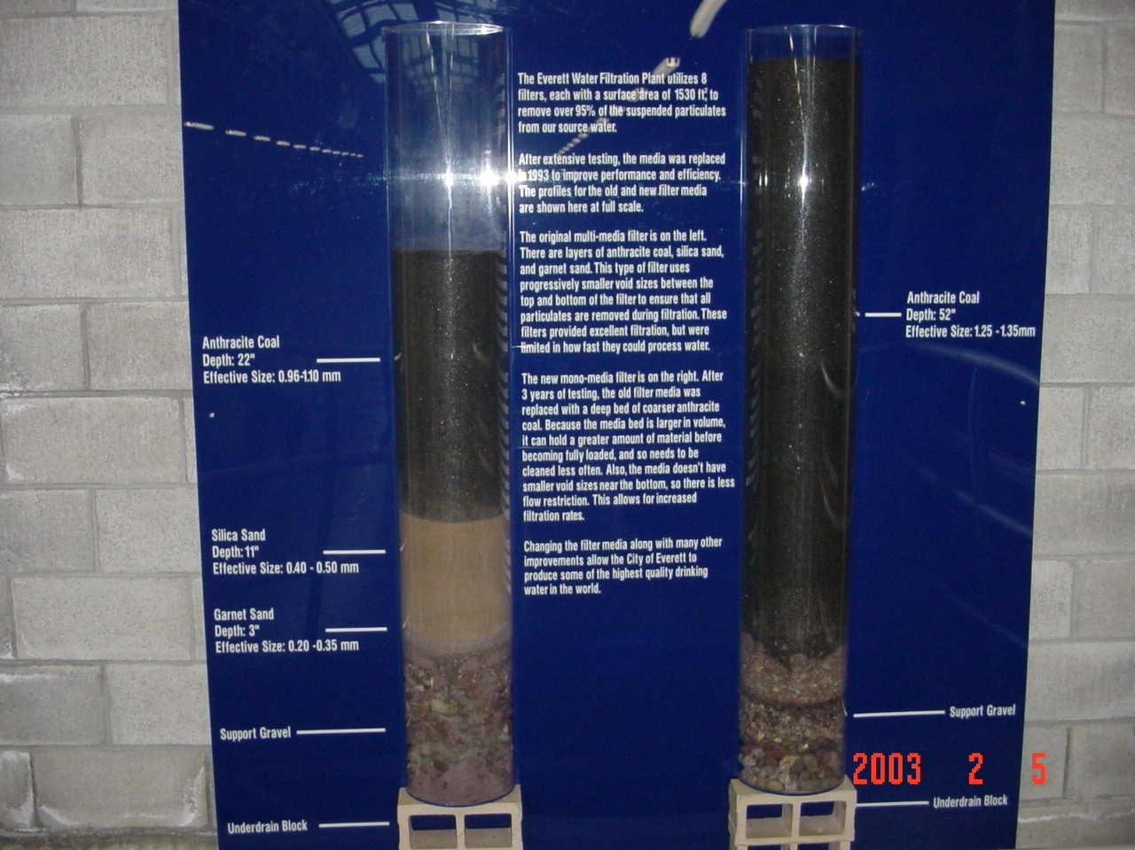

Slide 4
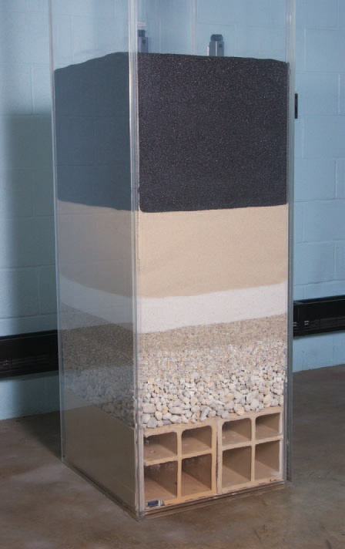
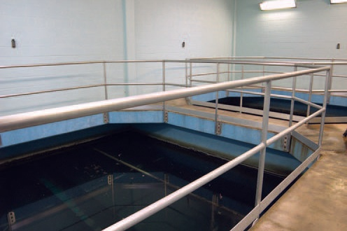
From: Water on Tap, USEPA pamphlet accessed on 01/04/09 at http://www.epa.gov/safewater/wot/pdfs/book_waterontap_full.pdf

Slide 5
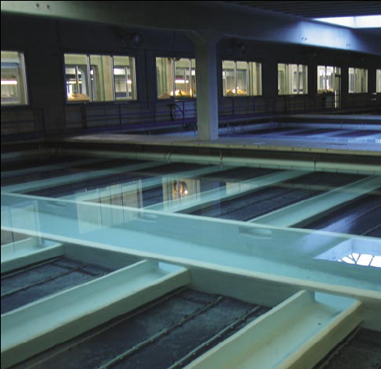
(From Opflow, November 2005)

Slide 6
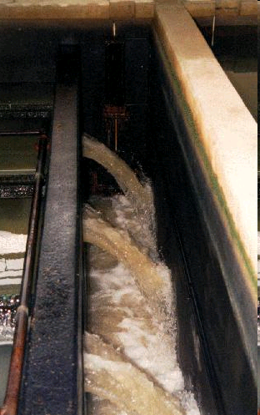
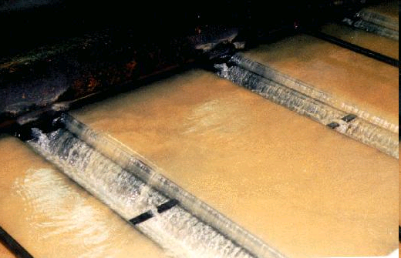
Filter backwash water flowing into (above) and out of (right) launders
Photos by Dan Gallagher
From: Virginia Tech Water Treatment Primer, accessed on 01/04/09 at http://www.cee.vt.edu/ewr/environmental/teach/wtprimer/backwash/backwash.html

Slide 7
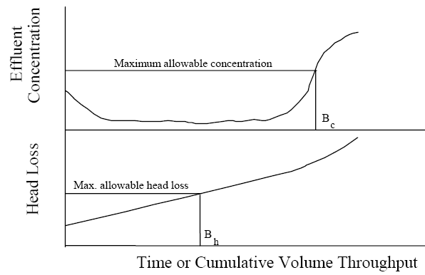

Slide 8
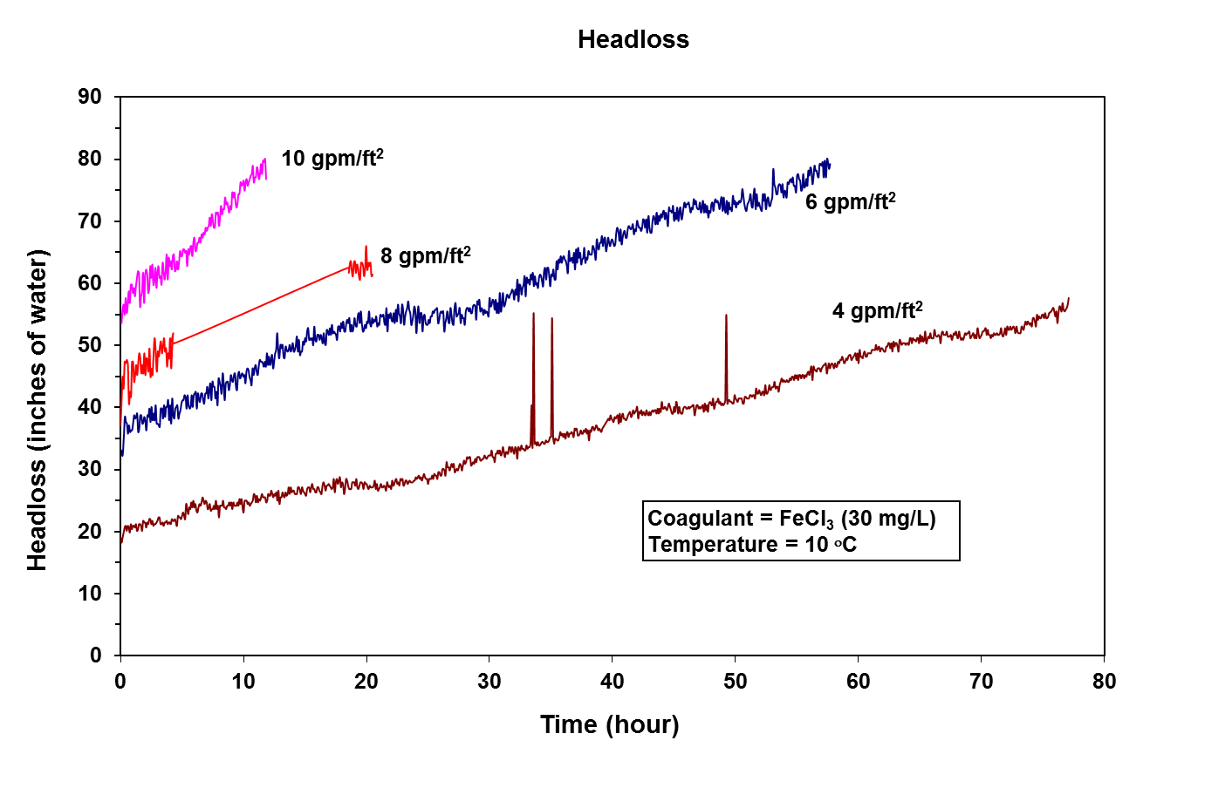

Slide 9
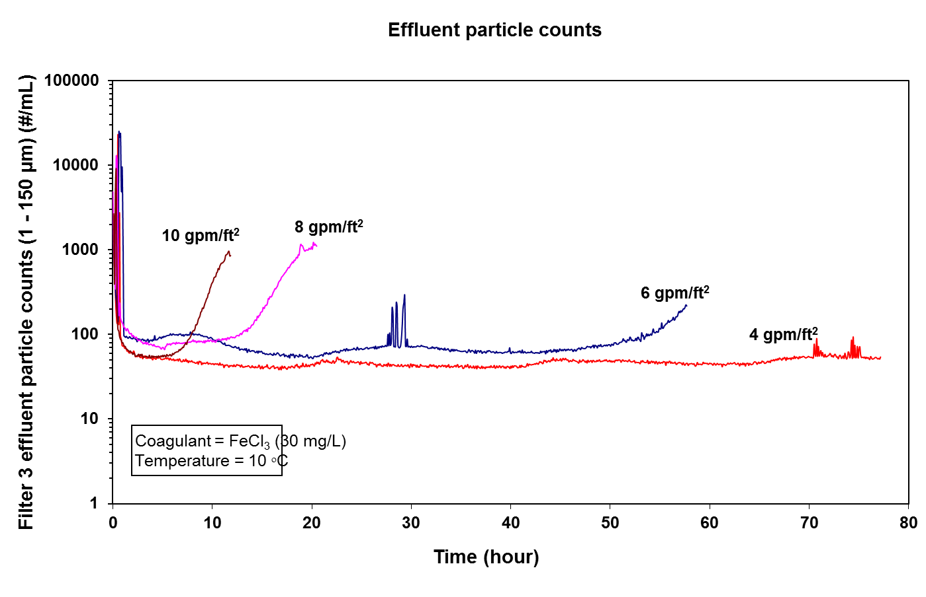

Slide 10
Filtration Complexity
Two dependent variables of importance
  Head Loss
  Effluent Quality
Never at Steady State
Two different modes of operation (filtration and backwashing)
Numerous Independent Variables

Slide 11
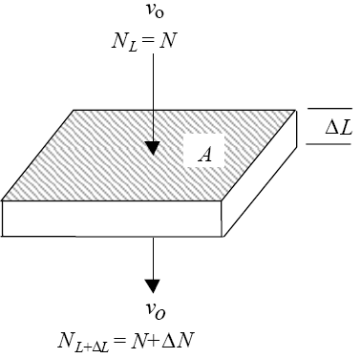

Slide 12
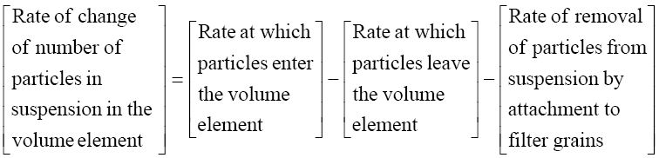
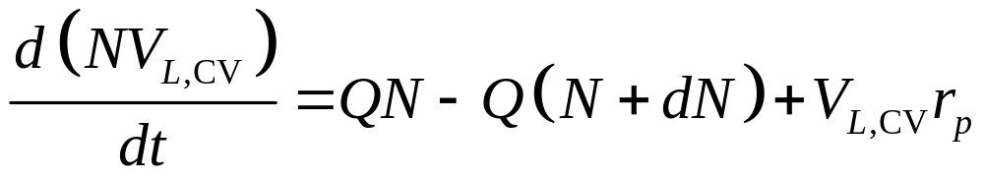
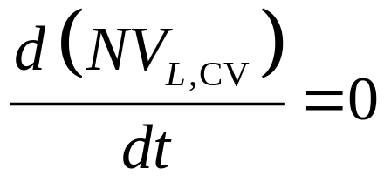
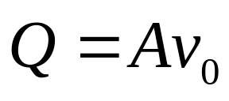
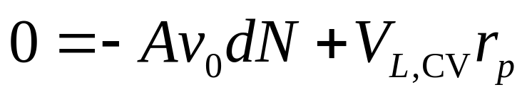
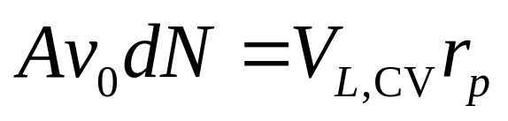
Assume pseudo-steady state, so

Slide 13
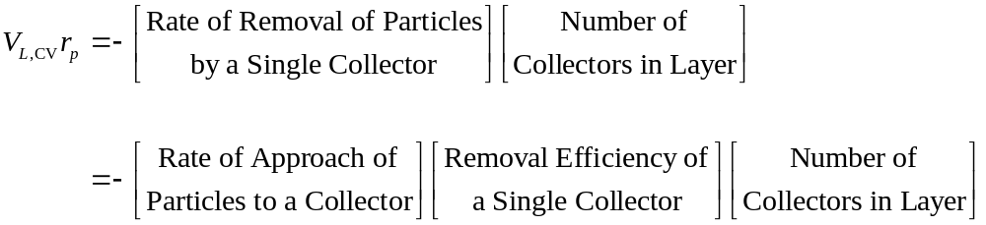
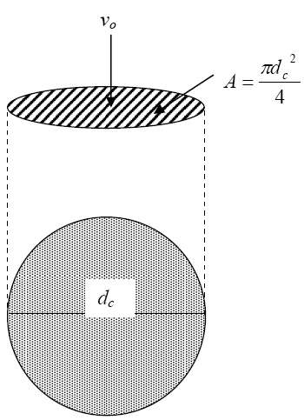
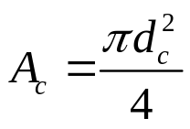
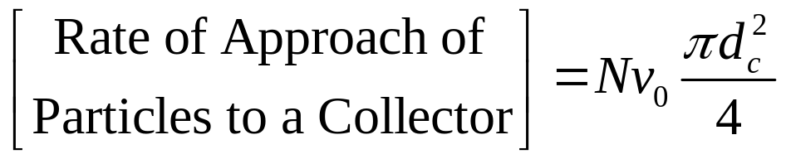
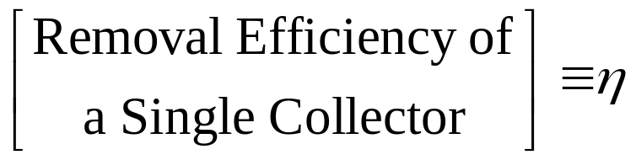
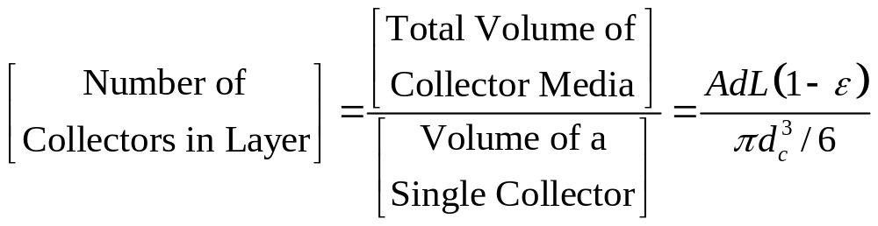

Slide 14
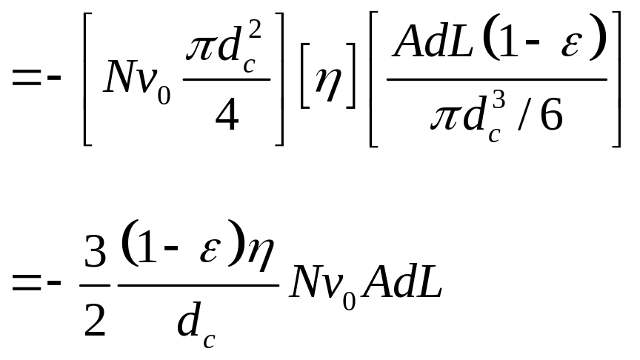
“Single Collector Removal Efficiency”

Slide 15
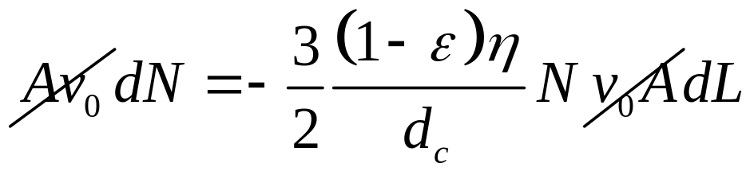
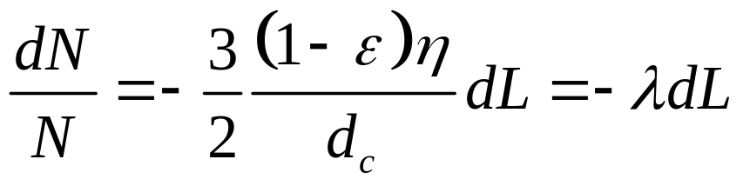
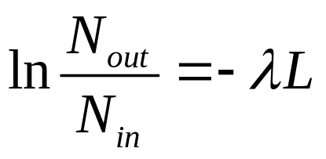
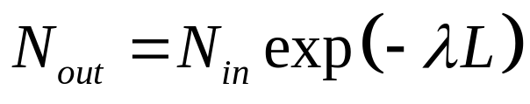
“Filter coefficient”

Slide 16
Summary: Mass Balance Analysis of Particle Removal in a Granular Filter
Based on relative sizes of particles and collectors, sieving is unimportant and removal can be modeled based on interactions with isolated “collector” grains
Assuming pseudo-steady state, concentration of any given type of particle is expected to decline exponentially with depth
Each type of particle has a different coefficient for the exponential loss rate
If we could predict η for a given type of particle, we could predict N_{out}/N_{in} for that particle

Slide 17
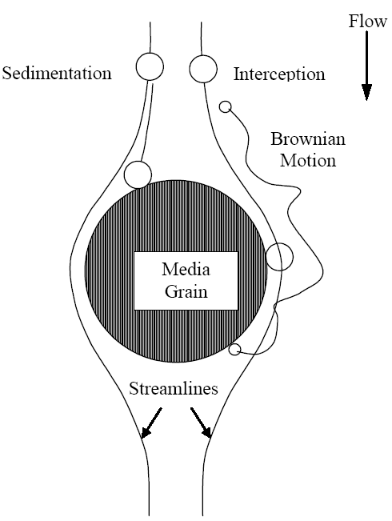


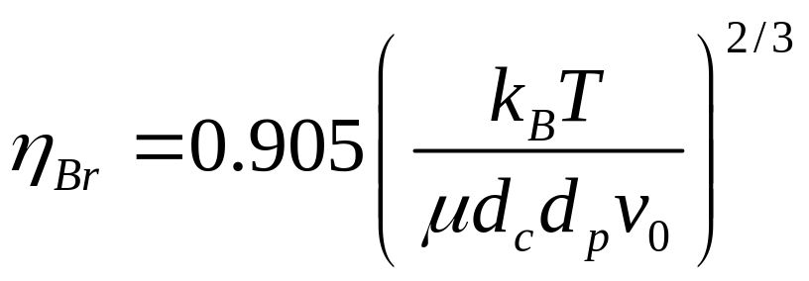


Slide 18
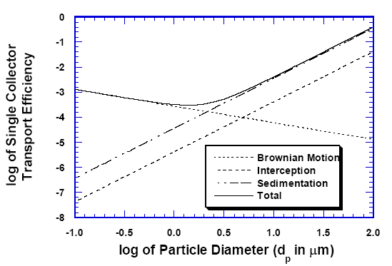

Slide 19
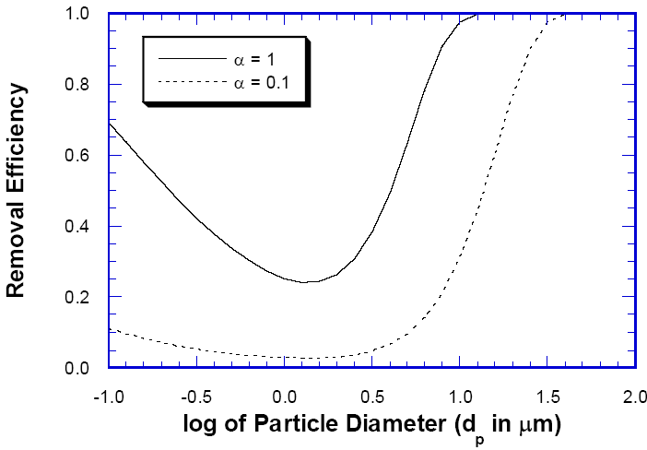

Slide 20
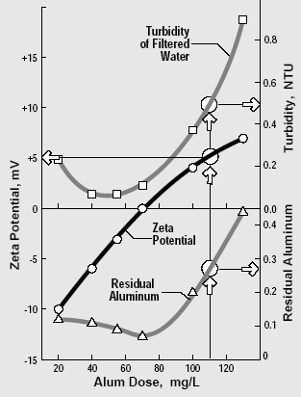

Slide 21
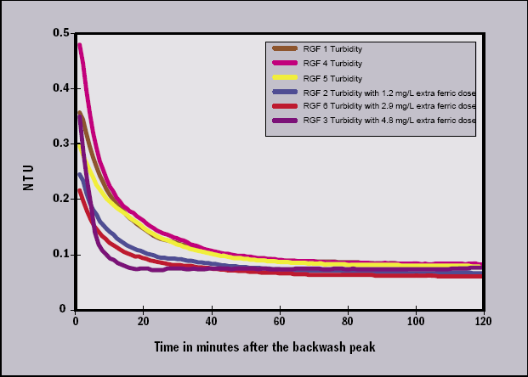
Accelerating Filter Ripening by Adding Coagulant to Filter Influent (Opflow 11/05)

Slide 22
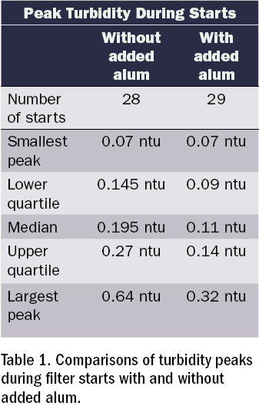
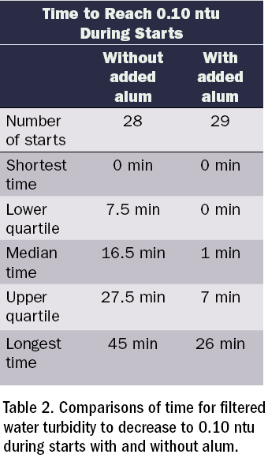
Accelerating Filter Ripening (Opflow 11/05)

Slide 23
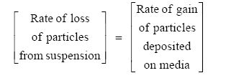



Modeling Filter Ripening
σ is specific deposit, mass deposited per unit volume of filter media
Relationship is assumed, not theoretical; a is the ripening coefficient

Slide 24
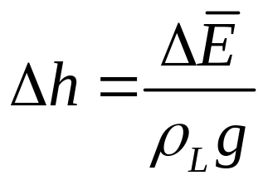
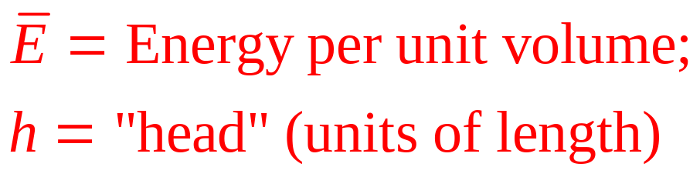
Head Loss in Clean Filters
h_{L} (“head loss”) refers to the loss of total energy per volume of water between the top of the filter bed and some other point (usually the bottom)
In a filter, the main contributions to fluid energy or head are elevation and pressure; the contribution of velocity is negligible

Slide 25
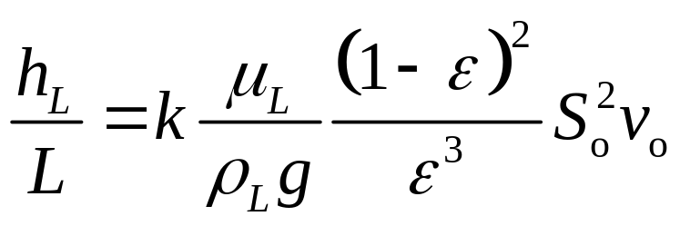
Head Loss in Clean Filters
For flow through a clean bed, headloss can be related to flow rate and geometry based on fluid dynamics principles and the equality of the gravitational force (causing flow) with the resistance force. The result is known as the Carman-Kozeny Eqn.:
Carman-Kozeny Eqn:
k is a geometric constant usually assume to equal 5
ε is porosity, typically ~0.4
S_{o} is surface area per unit volume of media
v_{o} is superficial velocity, Q/A

Slide 26
Components of Head in a Filter: No Flow Condition
Water Level
Top of media
Depth
h_{tot}
h_{P}
1
h_{el}
1
Head

Slide 27
Components of Head in a Filter: Flow Through a Clean Filter
Water Level
Top of media
Depth
Note: Blue and red arrows represent h_{L,p} and h_{L,tot}, respectively. At a given depth, they must be equal.
h_{tot}
h_{P}
h_{el}
n>1
1
Head

Slide 28
Components of Head in a Filter: Early in Filter Run
Water Level
Top of media
Depth
h_{P}
h_{tot}
h_{el}
n
1
Head

Slide 29
Components of Head in a Filter: Late in Filter Run
Water Level
Top of media
Depth
h_{P}
h_{tot}
h_{el}
n
1
Head

Slide 30
Use of Piezometers to Measure Total Head and Pressure Head in a Filter
Water Level
Top of media
Depth
Port 4
Port 3
h_{p,2}
Port 2
h_{tot,2}
Port 1
Head
h_{p,2} = Pressure head at Port 2, relative to atmospheric
h_{tot,2} = Total head at Port 2, relative to datum at bottom of filter

Slide 31
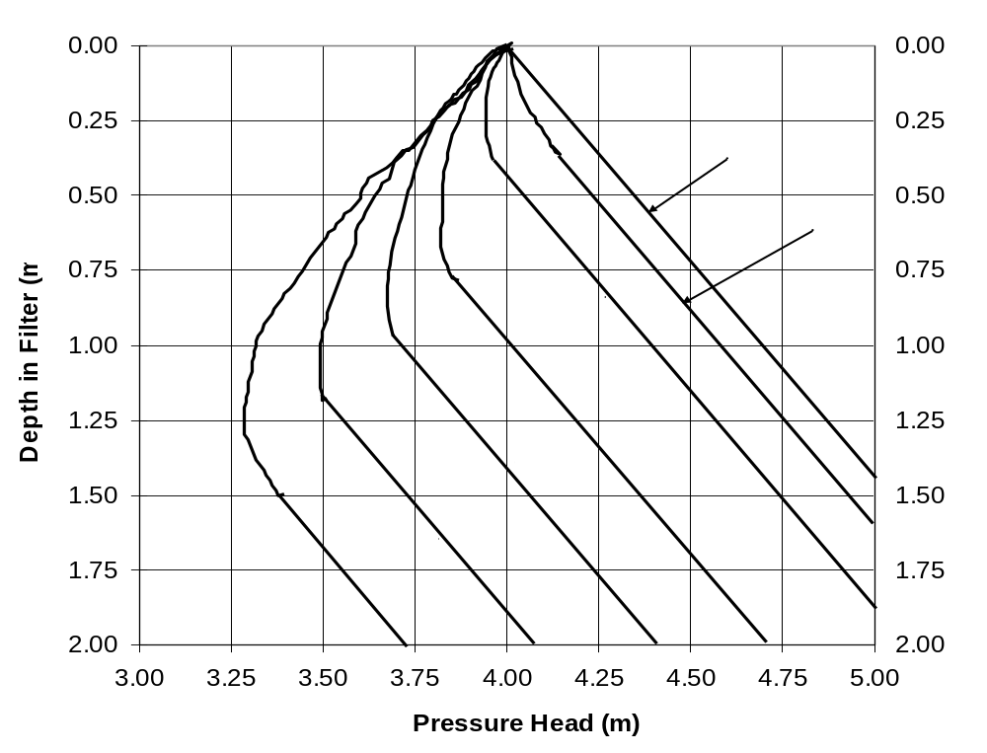
Typical Headloss Profiles in a Rapid Sand Filter

Slide 32
Head loss is entirely due to changes in h_{p}
With no flow, head loss is zero everywhere. As a result, total head loss from top of bed to a given location equals pressure head loss at that location compared to no-flow condition
For constant-flow operation, head loss gradient through clean media is constant (throughout bed initially, only at bottom later)
Total head (elevation plus pressure) must decrease monotonically in direction of flow
Pressure head is universally reported based on gage pressure; it can be negative (vacuum relative to atmosphere), but such a situation is undesirable

